Slide 1
Regularization for Deep Learning
By Denys Chechelnytskyy

Slide 2

Notes:
Credits to: https://xkcd.com/1838/

Slide 3
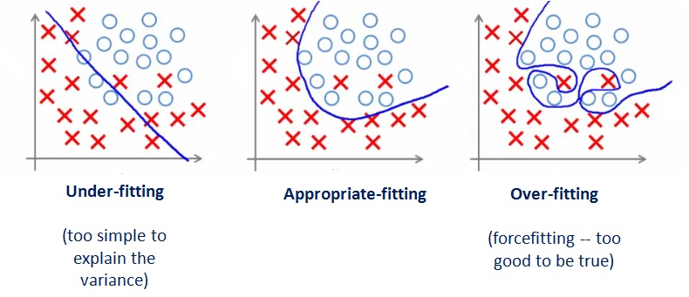
Overfitting
Notes:
Image from: https://affineanalytics.wordpress.com/page/2/

Slide 4
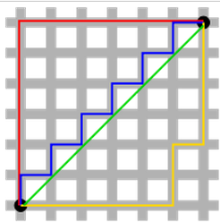
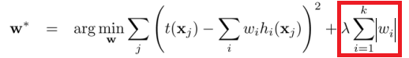
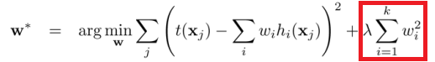
L1 & L2 (weight decay) regularization
Different from loss function
Least absolute deviations (errors) vs least squared error
Add regularization term to prevent overfitting
L1:
L2:
Notes:
Image and formulas from: http://www.chioka.in/differences-between-l1-and-l2-as-loss-function-and-regularization/

Slide 5
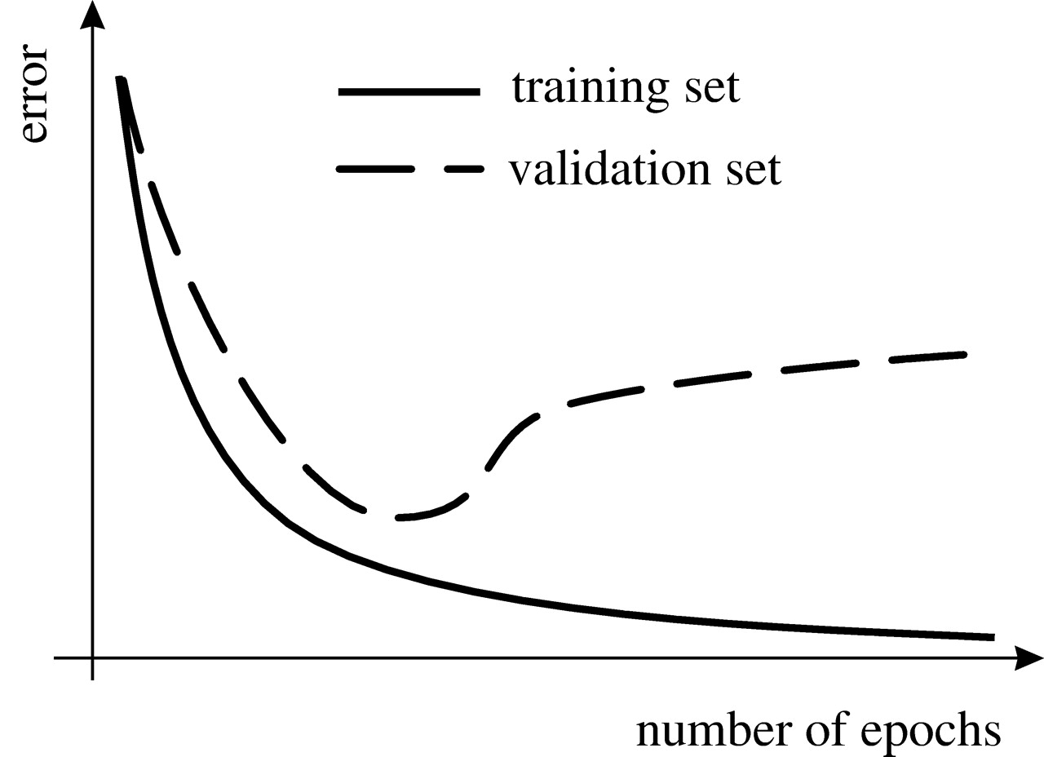

Early stopping
Notes:
Image taken from: http://rstb.royalsocietypublishing.org/content/362/1479/339

Slide 6
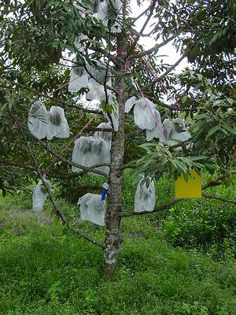
Bagging (ensemble)
“A simple way to prevent insects from attacking fruits…”
Notes:
Image and cited from: http://ipm-info.org/components-of-ipm/bagging/

Slide 7
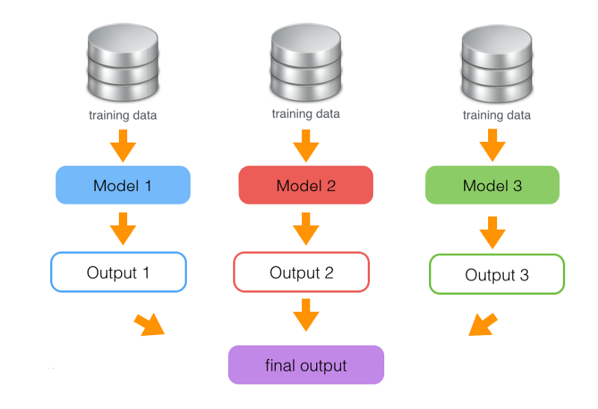
Bagging (ensemble) in DL
Notes:
Image taken from: https://www.quora.com/Can-you-recommend-some-good-books-blogs-articles-and-papers-dedicated-to-model-ensembles-and-especially-model-stacking-a-k-a-hybrid-model-ensembles

Slide 8
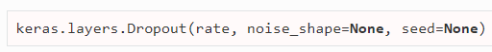
Dropout
Remove hidden units stochastically
Hidden units do not co-adapt
More impact from hidden units
Dropout probability (usually 0.5)
TensorFlow:
Keras:
dropout( x, keep_prob, noise_shape=None, seed=None, name=None )
Notes:
Credits to: https://www.youtube.com/watch?v=UcKPdAM8cnI

Slide 9
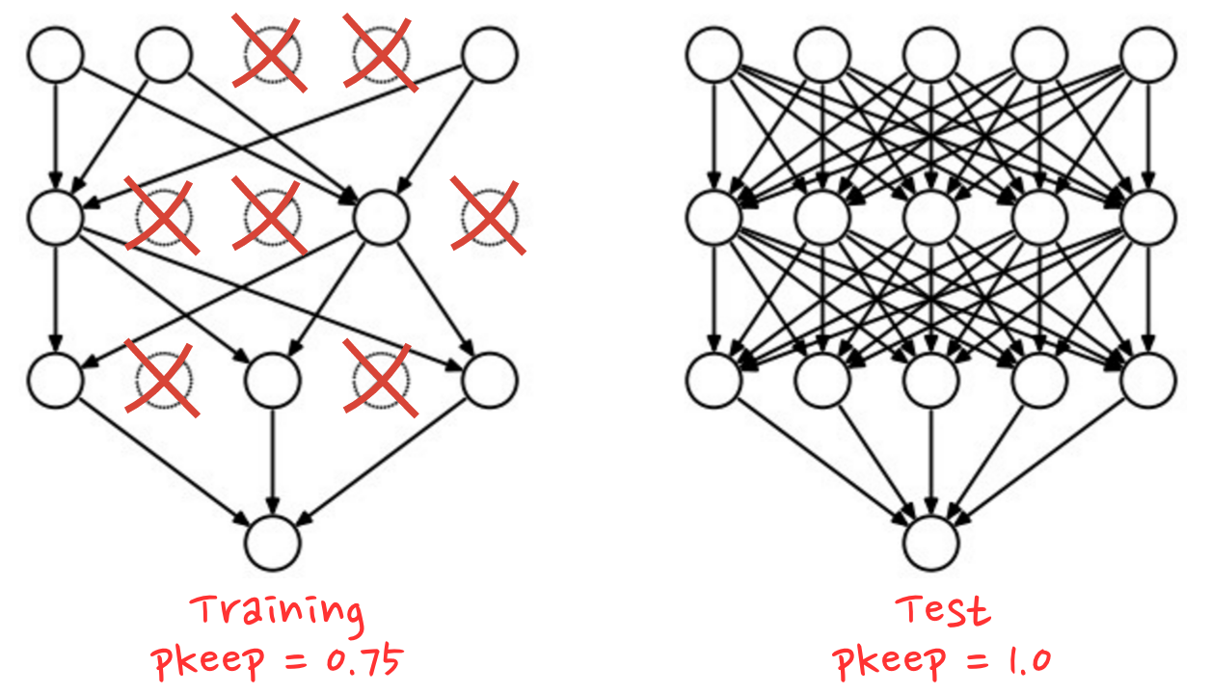
Notes:
Image from: https://codelabs.developers.google.com/codelabs/cloud-tensorflow-mnist/#9

Slide 10
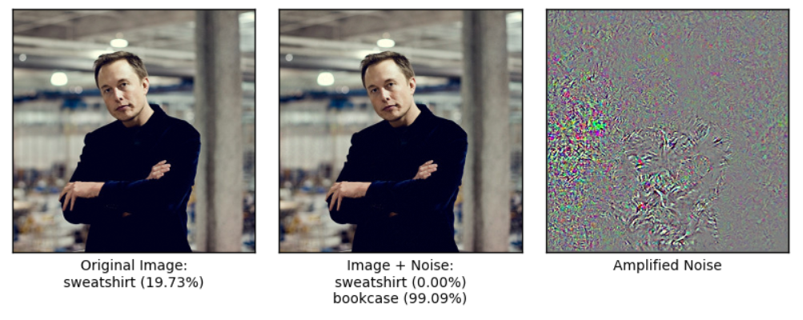
Adversarial noise (Noise Robustness)
Notes:
Image retrieved from: https://github.com/Hvass-Labs/TensorFlow-Tutorials

Slide 11
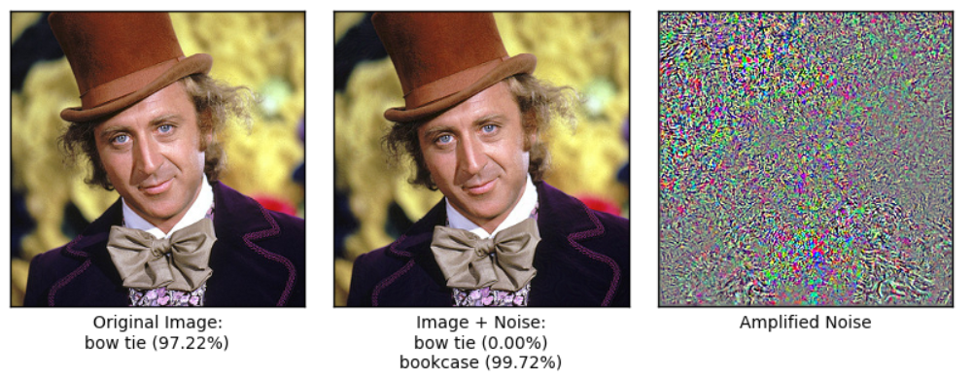
Notes:
Image retrieved from: https://github.com/Hvass-Labs/TensorFlow-Tutorials

Slide 12
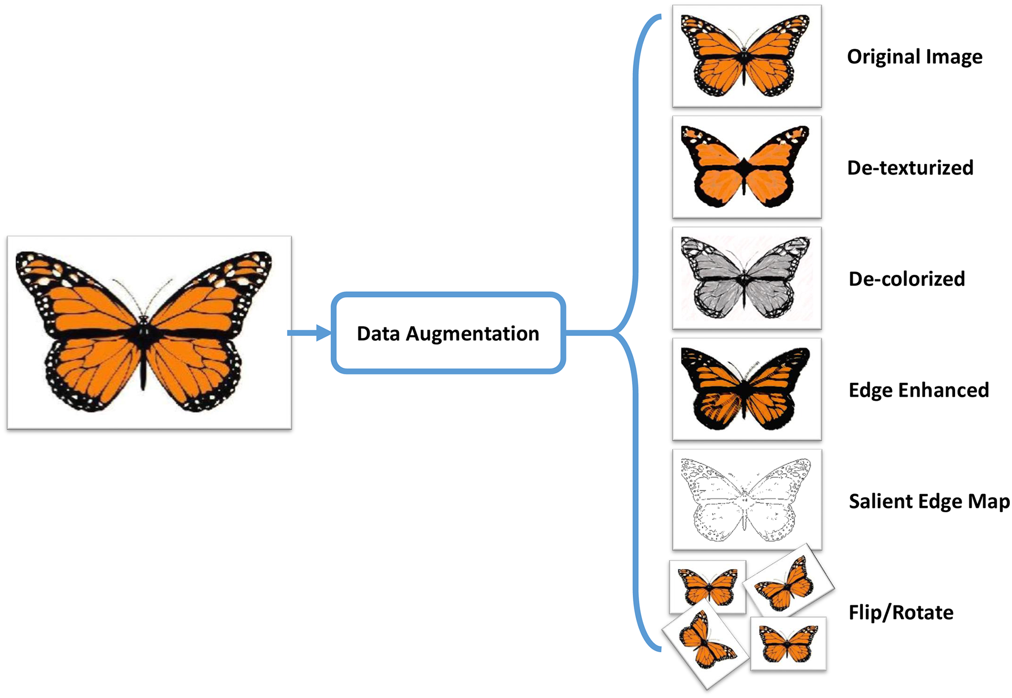
Data augmentation
Notes:
Image taken from: http://journals.plos.org/plosone/article?id=10.1371/journal.pone.0183838

Slide 13
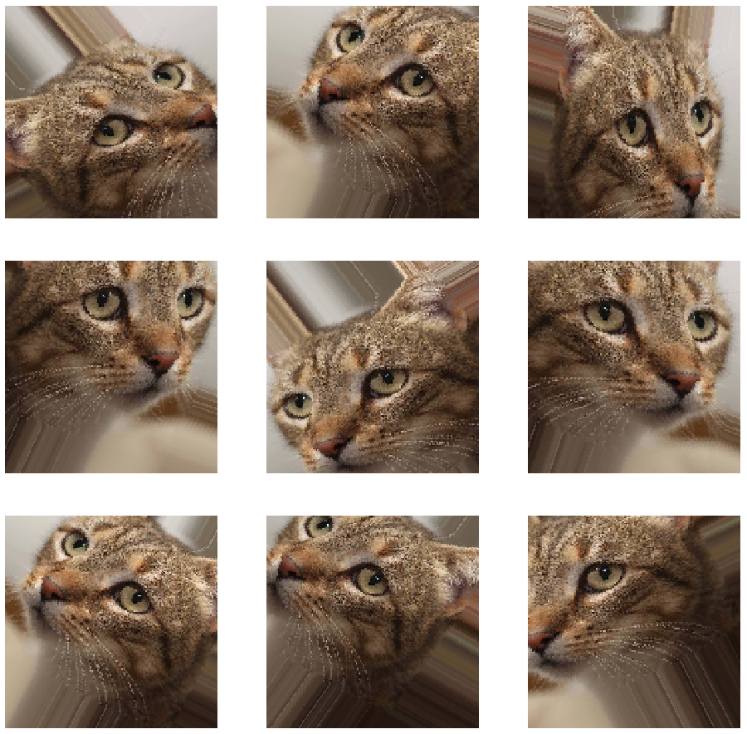


Data augmentation
Different approaches depending on the data.
Example for images:
Example for text:
Notes:
Image from: https://towardsdatascience.com/applied-deep-learning-part-4-convolutional-neural-networks-584bc134c1e2
GitHub image taken form: https://sunlightmedia.org/using-github-social-coding/
Augmentor image taken from: https://github.com/mdbloice/Augmentor

Slide 14

Self study
https://codelabs.developers.google.com/codelabs/cloud-tensorflow-mnist/

Slide 15

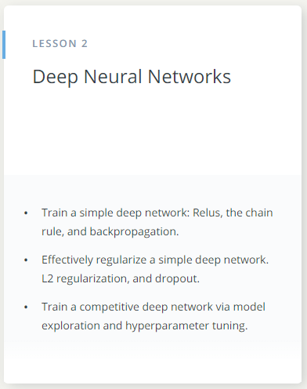
Deep Learning by Google

Slide 16

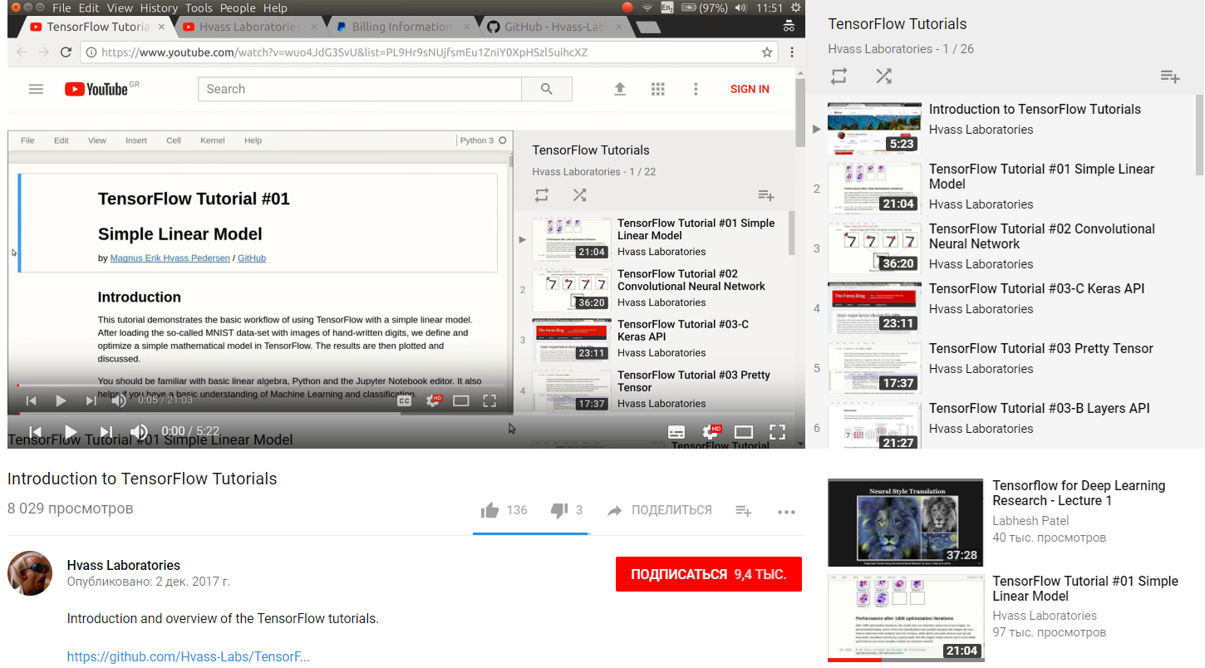


TensorFlow Tutorials by Magnus Erik Hvass Pedersen
Notes:
Youtube icon taken from: https://www.vexels.com/png-svg/preview/141532/youtube-rubber-icon
GitHub Repo taken from: http://www.escope.cz/en/extensions/github-repo/github-repo-documentation
5 stars taken from: http://www.aminhotel.com/images/1w.png

Slide 17


Notes:
Image taken form: http://www.indianyouth.net/youth-country-confident-confused/
Q&A taken from: https://www.onlinewebfonts.com/icon/569498

